Slide 1
Arduino Microcontroller for a model Hen-House

Slide 2
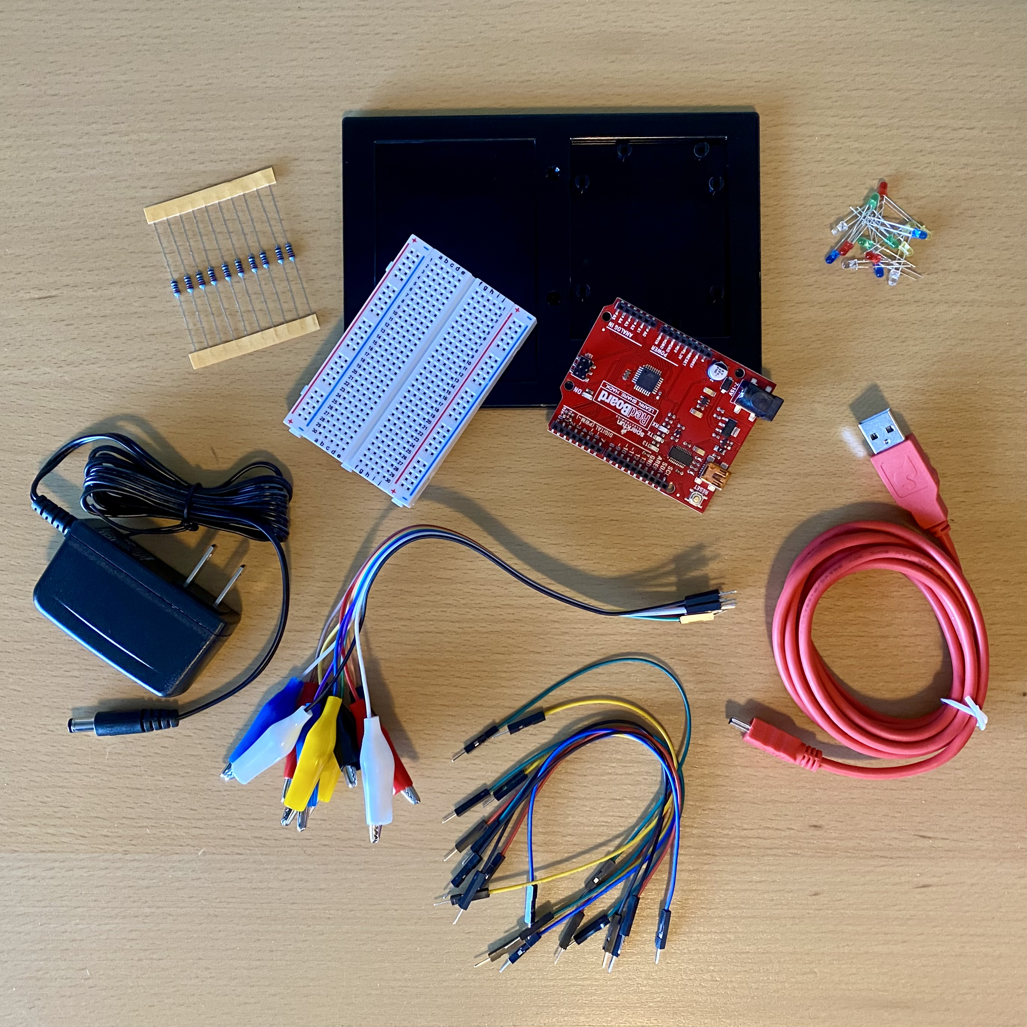
Kit* Materials
Arduino Microcontroller – SparkFun RedBoard
Breadboard
Arduino and breadboard holder
USB Mini-B Cable
Wall adapter power supply
Resistors – not used in this example
3mm LEDs in assorted colors
Jumper wires in assorted colors
Test leads – alligator clip with pigtail in assorted colors
Screwdriver
Computer (Windows, Mac OS X, or Linux) – not included
Arduino Software – not included
*Arduino Microcontroller Kit, available from agclassroomstore.com.

Slide 3
new to working with Arduino?
Learn about the SparkFun RedBoard
https://learn.sparkfun.com/tutorials/redboard-hookup-guide?_ga=2.253854920.1963503614.1546674686-1301118510.1532554968
And other Arduino microcontrollers
https://www.arduino.cc/en/Guide/HomePage
https://www.tinkercad.com/
https://learn.adafruit.com/category/learn-arduino
https://www.instructables.com/class/Arduino-Class/
http://www.ladyada.net/learn/arduino/
https://www.youtube.com

Slide 4
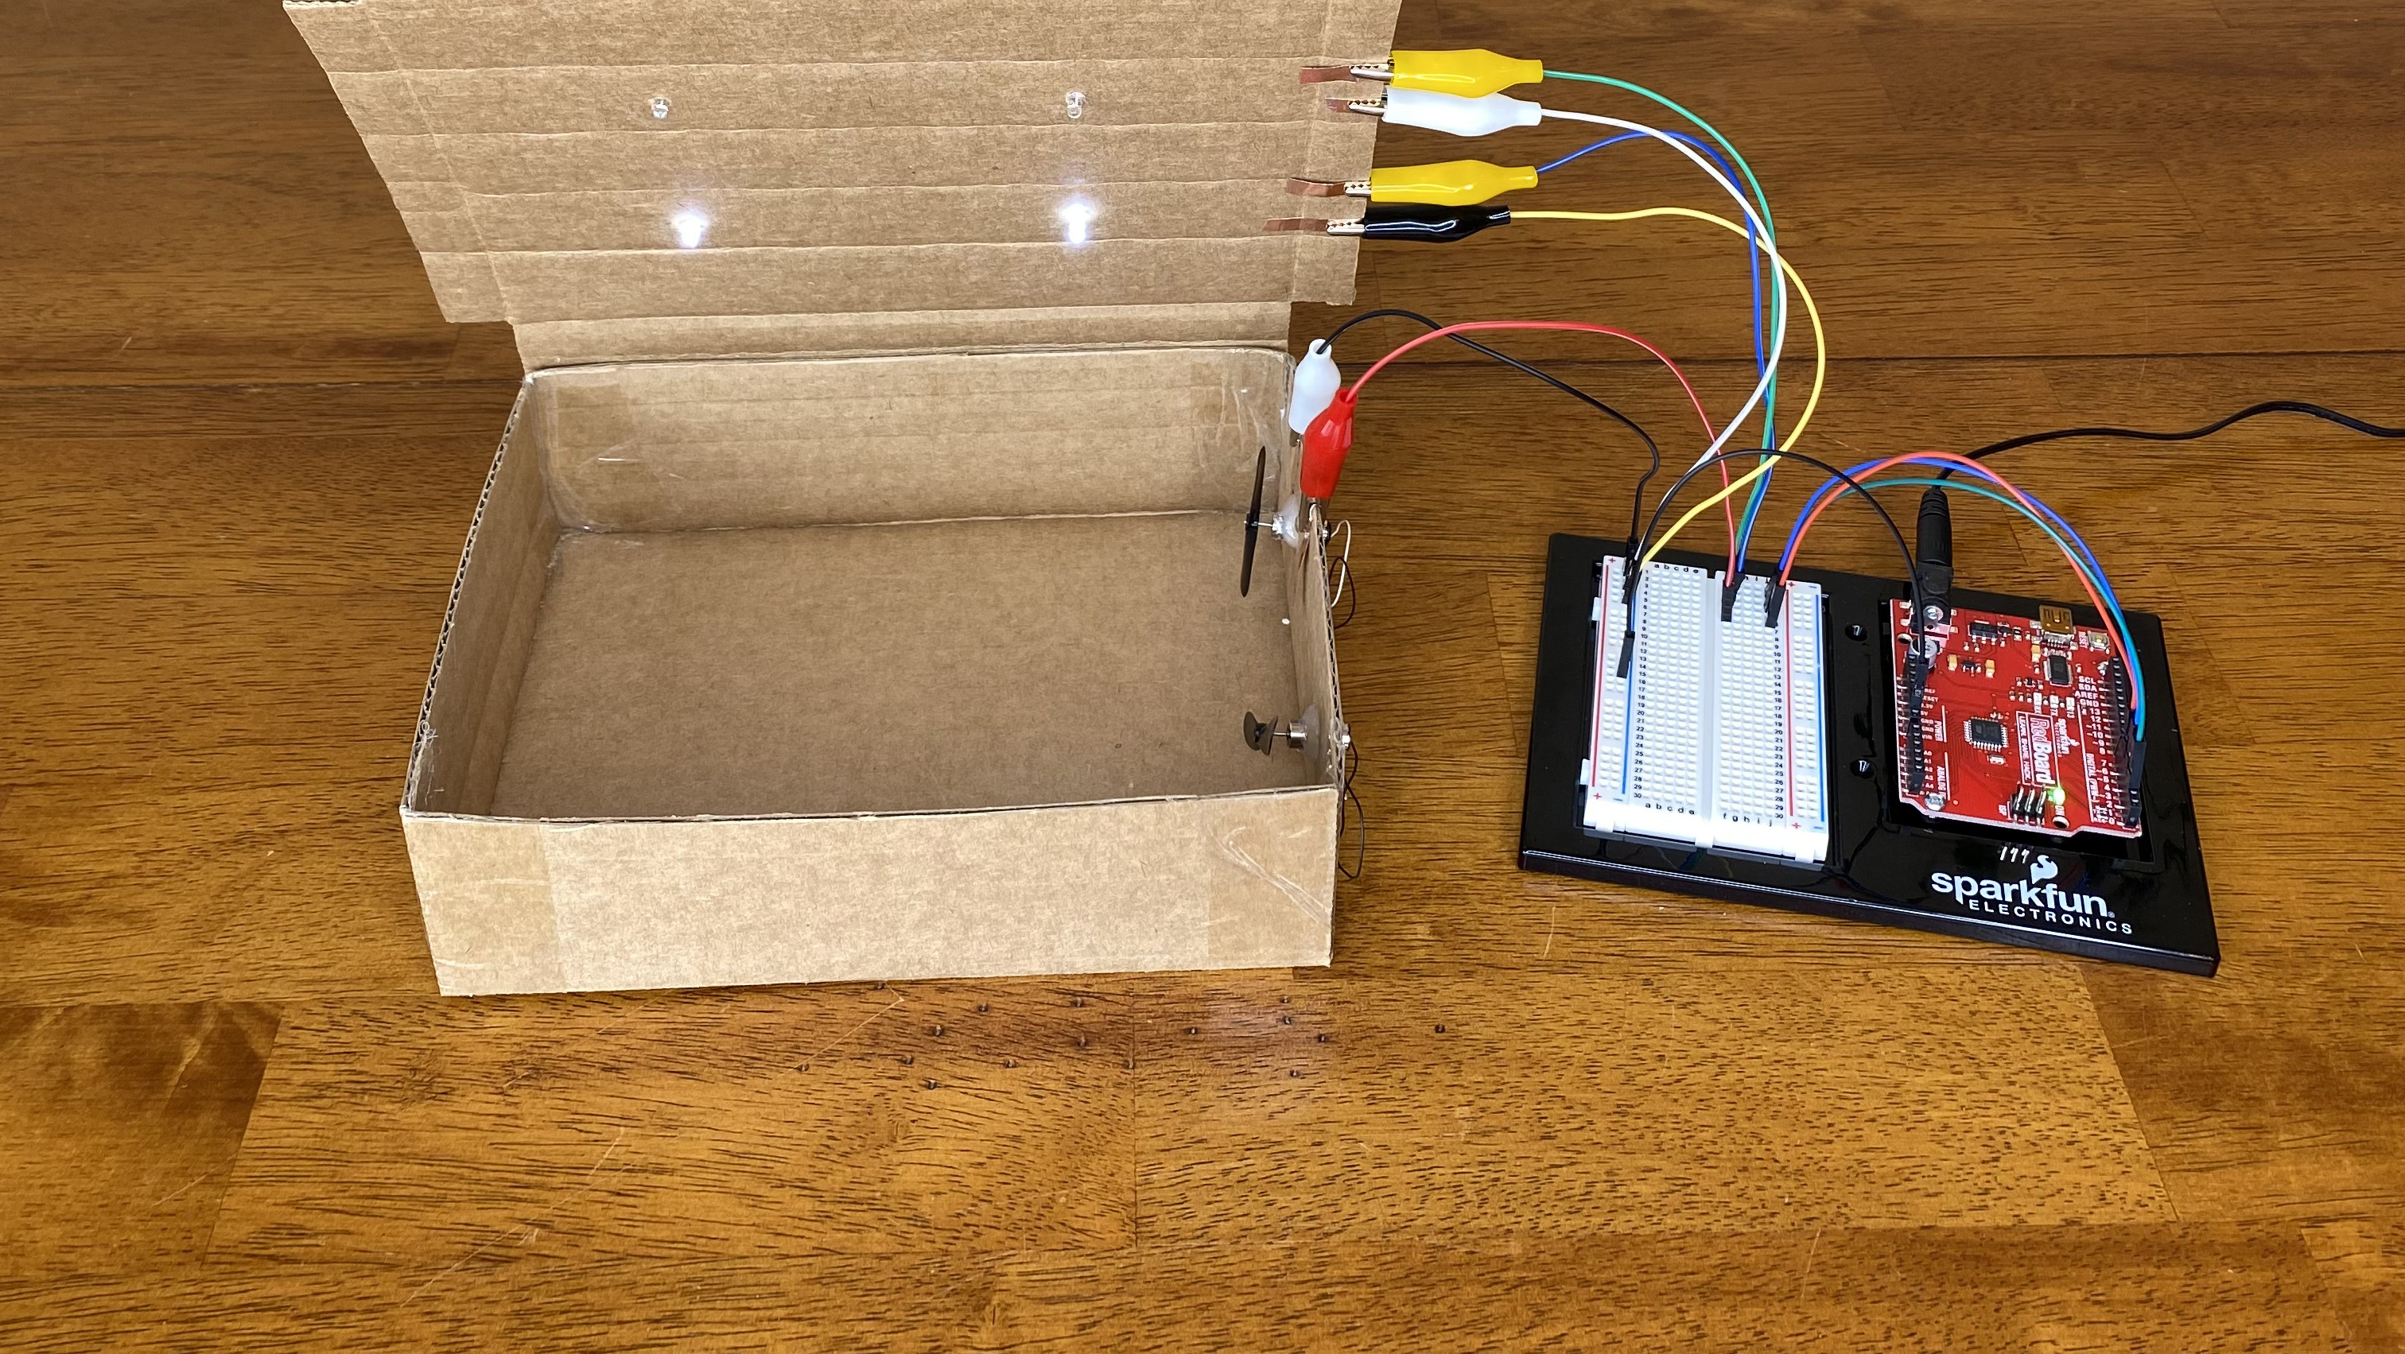
THIS EXAMPLE USES A SIMPLE BLINK PROGRAM TO CONTROL THE LIGHTS AND FANS ON A MODEL HEN HOUSE.

Slide 5
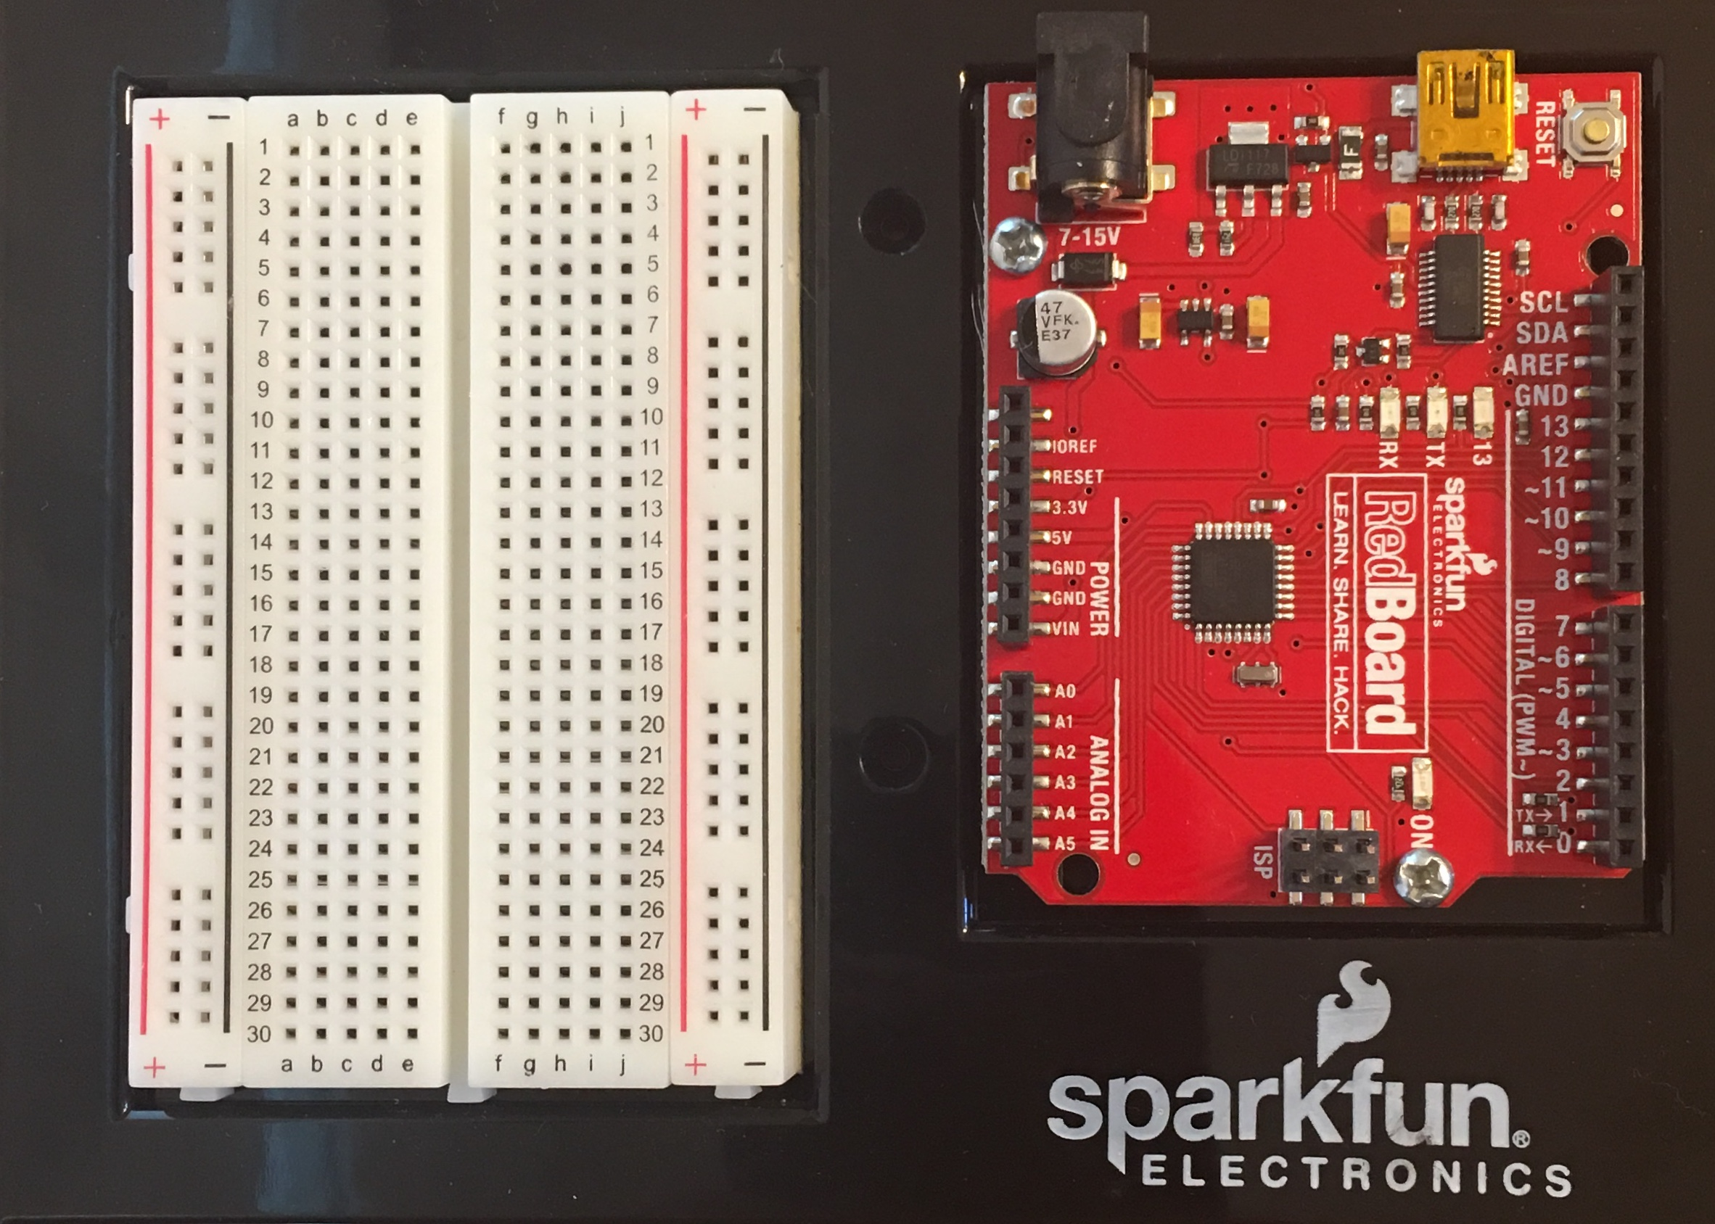
ATTACH THE BREADBOARD AND ARDUINO REDBOARD TO THE BLACK HOLDER.

Slide 6
Program the Arduino

Slide 7
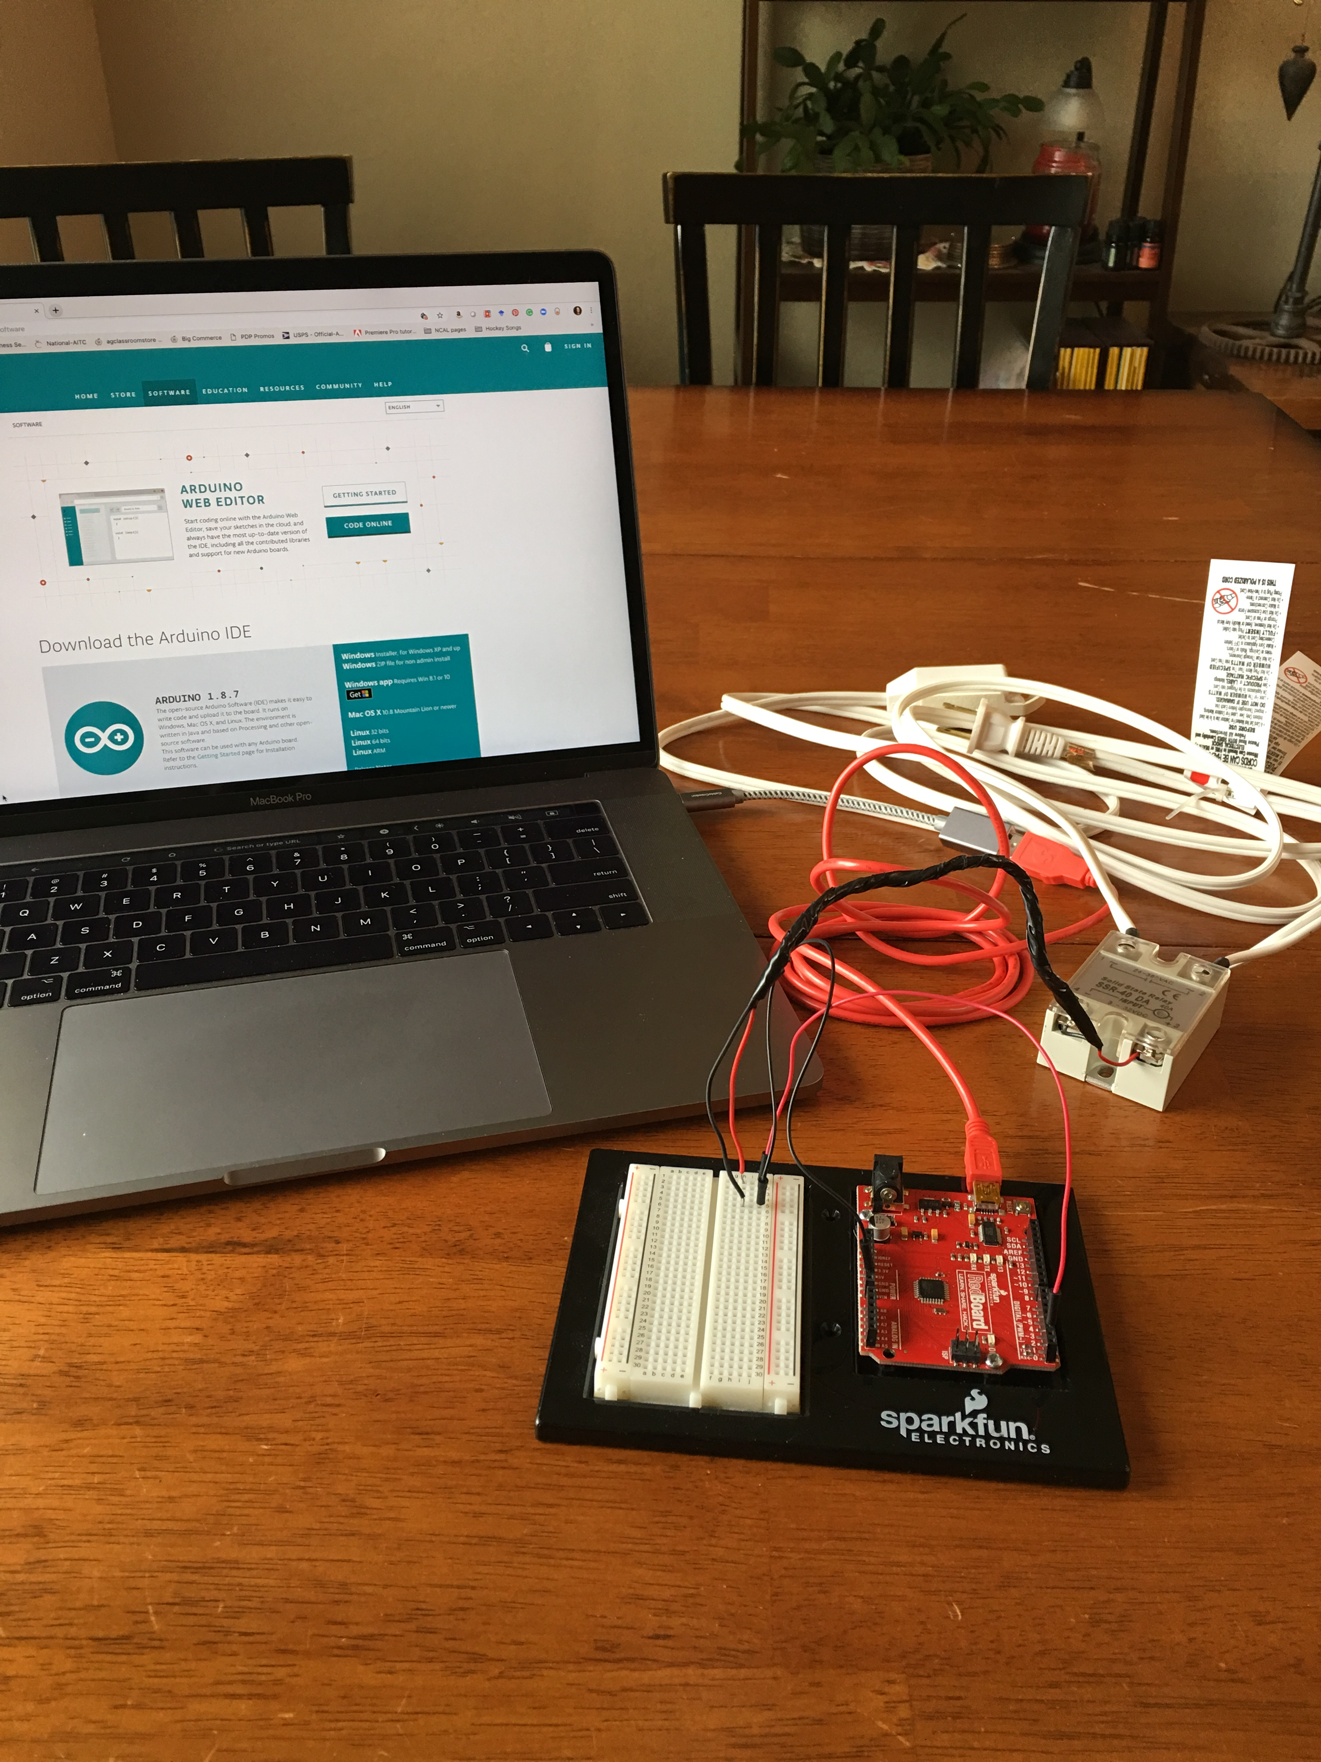
download Arduino IDE HTTPS://WWW.ARDUINO.CC/EN/MAIN/SOFTWARE

Slide 8
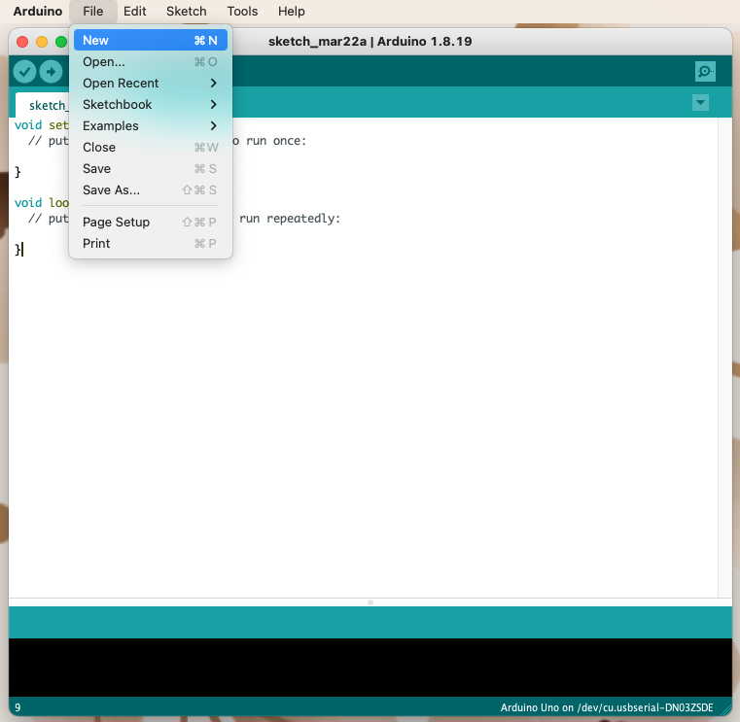
start a new program
File> New

Slide 9
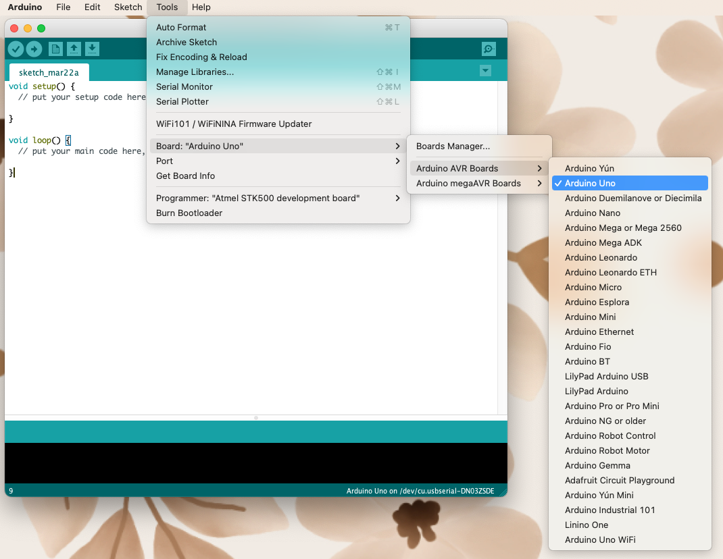
Select the Type of Arduino Board
You are using tools > Board >Arduino AVR Boards> Arduino Uno

Slide 10
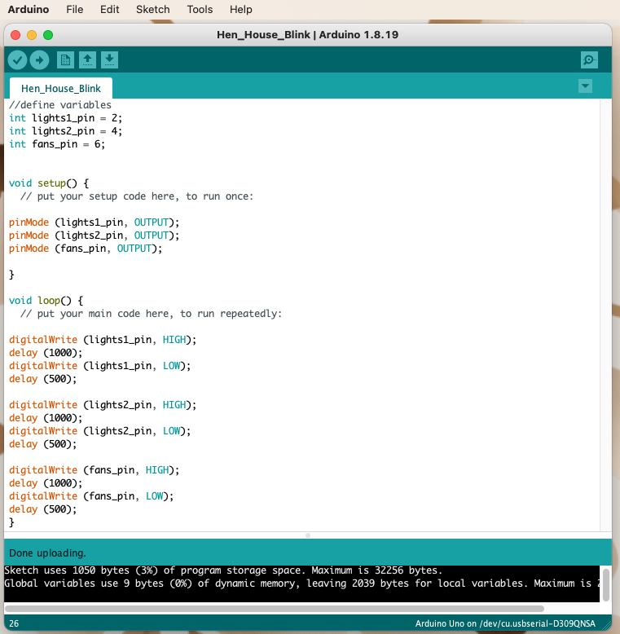
Write a Program the example program is a simple blink program with three outputs.

Slide 11
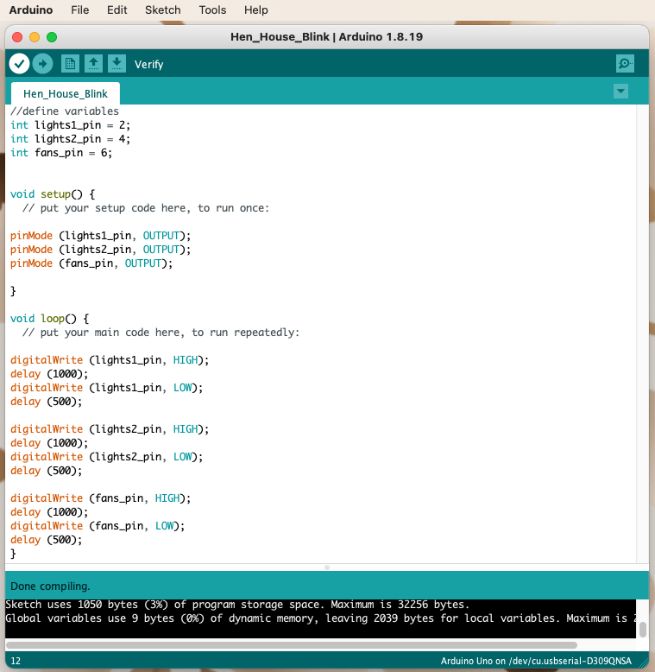
Verify the program by clicking on the button with a checkmark

Slide 12
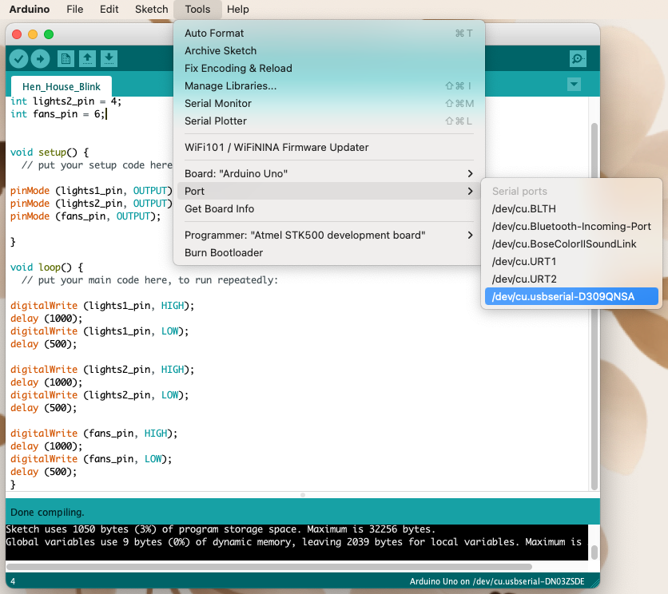
Connect the microcontroller to the computer Using the red USB Mini-B Cable tools> Port>
USB serial port

Slide 13
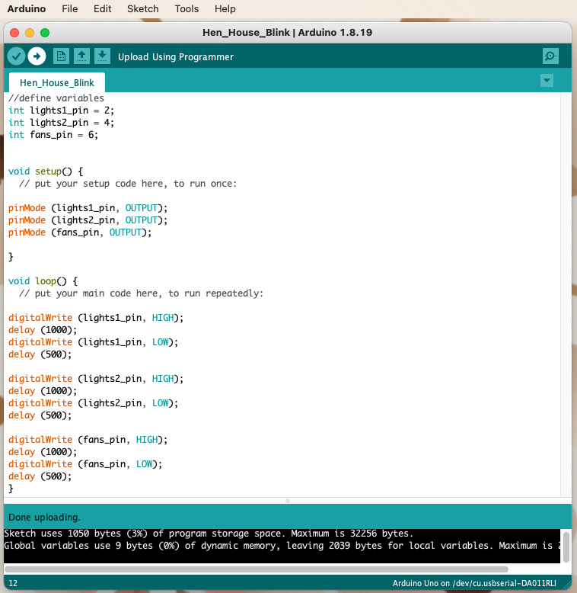
Upload the program to the RedBoard
Disconnect the Redboard from the computer

Slide 14
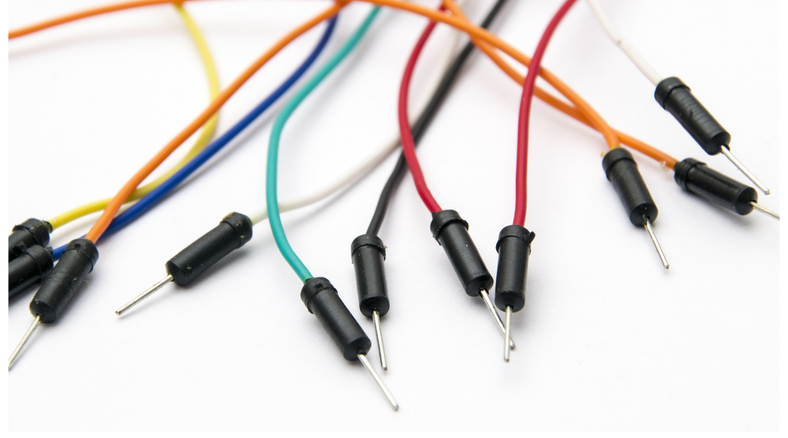
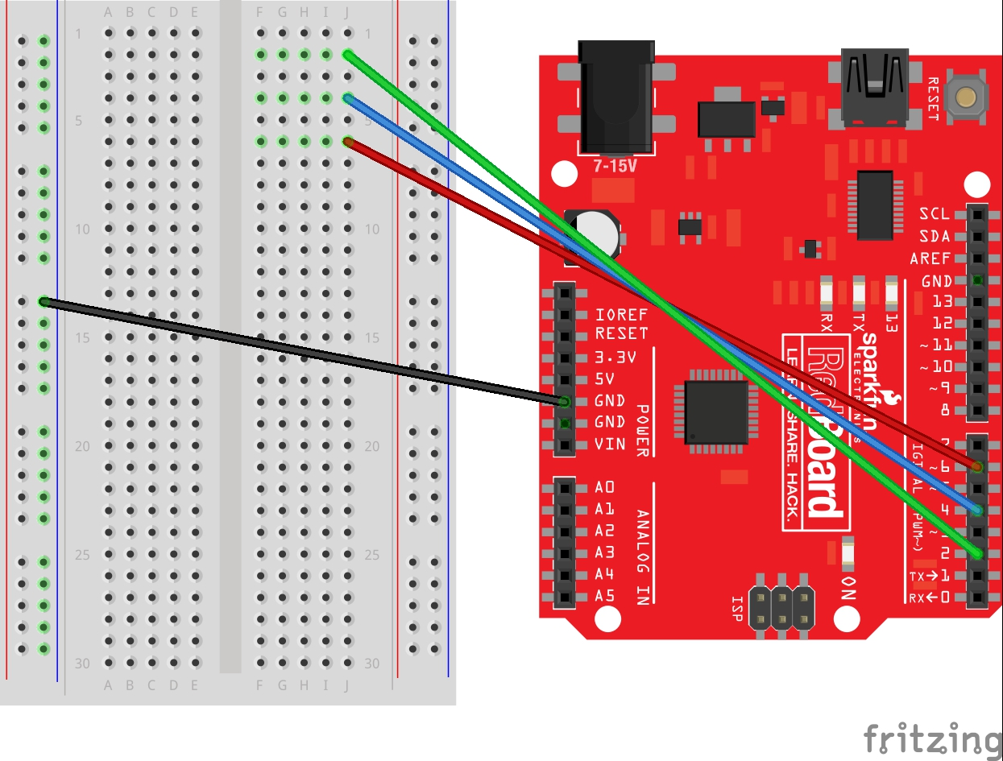
USE JUMPER WIRES TO CONNECT THE ARDUINO TO THE BREADBOARD.
THE GREEN WIRE CONNECTS PIN 2 TO HOLE J2.
THE BLUE WIRE CONNECTS
PIN 4 TO HOLE J4.
THE RED WIRE CONNECTS
PIN 6 TO HOLE J6.
THE BLACK WIRE CONNECTS THE GROUND PIN (GND) TO THE NEGATIVE RAIL ON THE LEFT SIDE OF THE BREADBOARD.

Slide 15
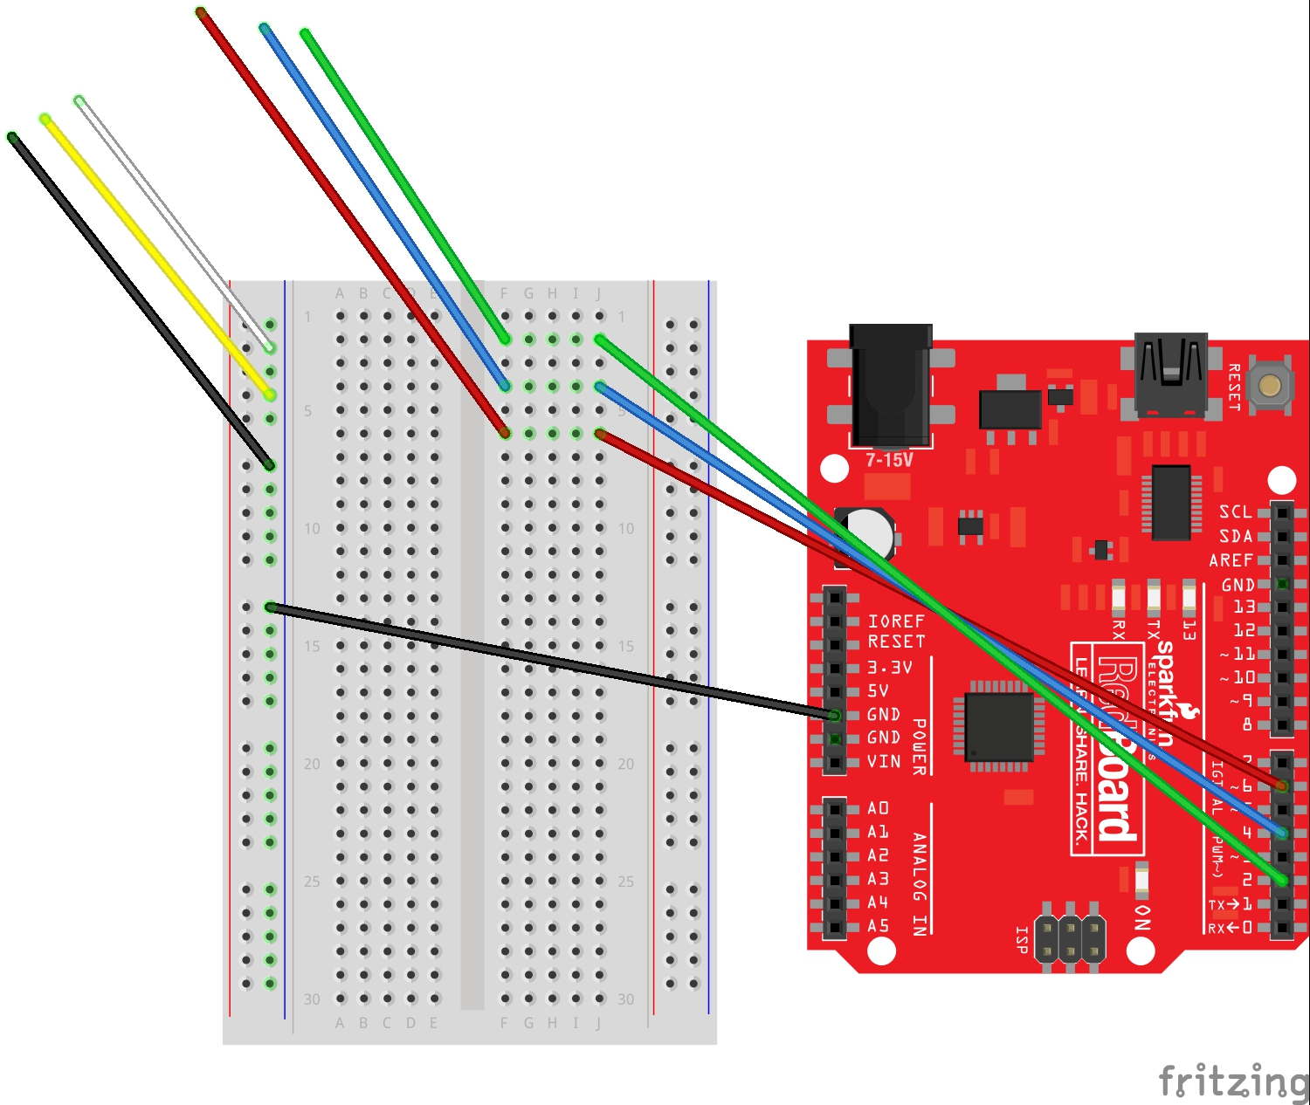
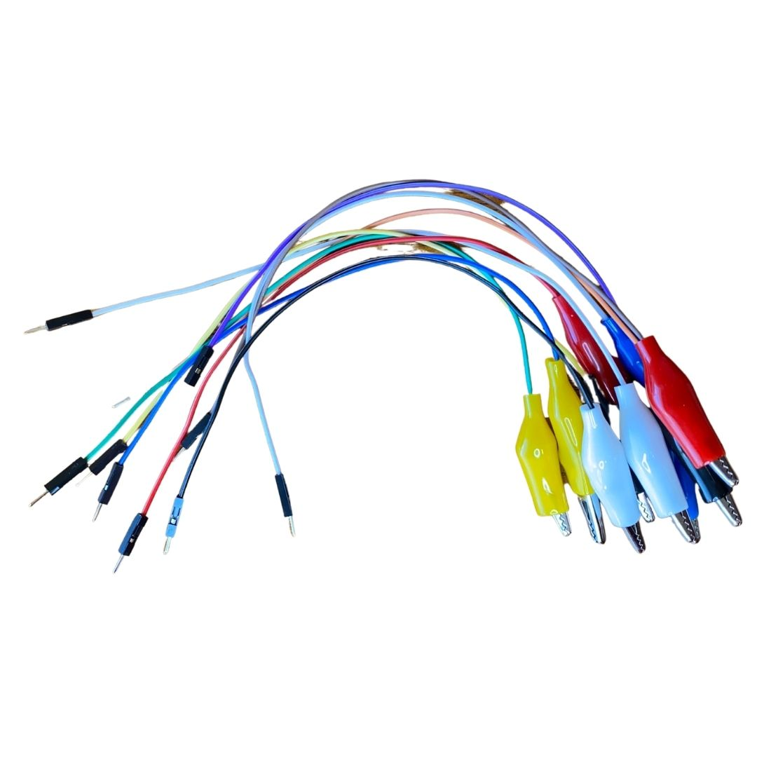
PLACE TEST LEADS WITH ALLIGATOR CLIPS IN THE BREAD BOARD.
ADD TEST LEADS TO HOLES F2, F4, AND F6. THESE TEST LEADS CARRY A POSITIVE CHARGE.
ADD TEST LEADS TO THE THE NEGATIVE RAIL ON THE LEFT SIDE OF THE BREADBOARD. THESE TEST LEADS CARRY A NEGATIVE CHARGE.

Slide 16
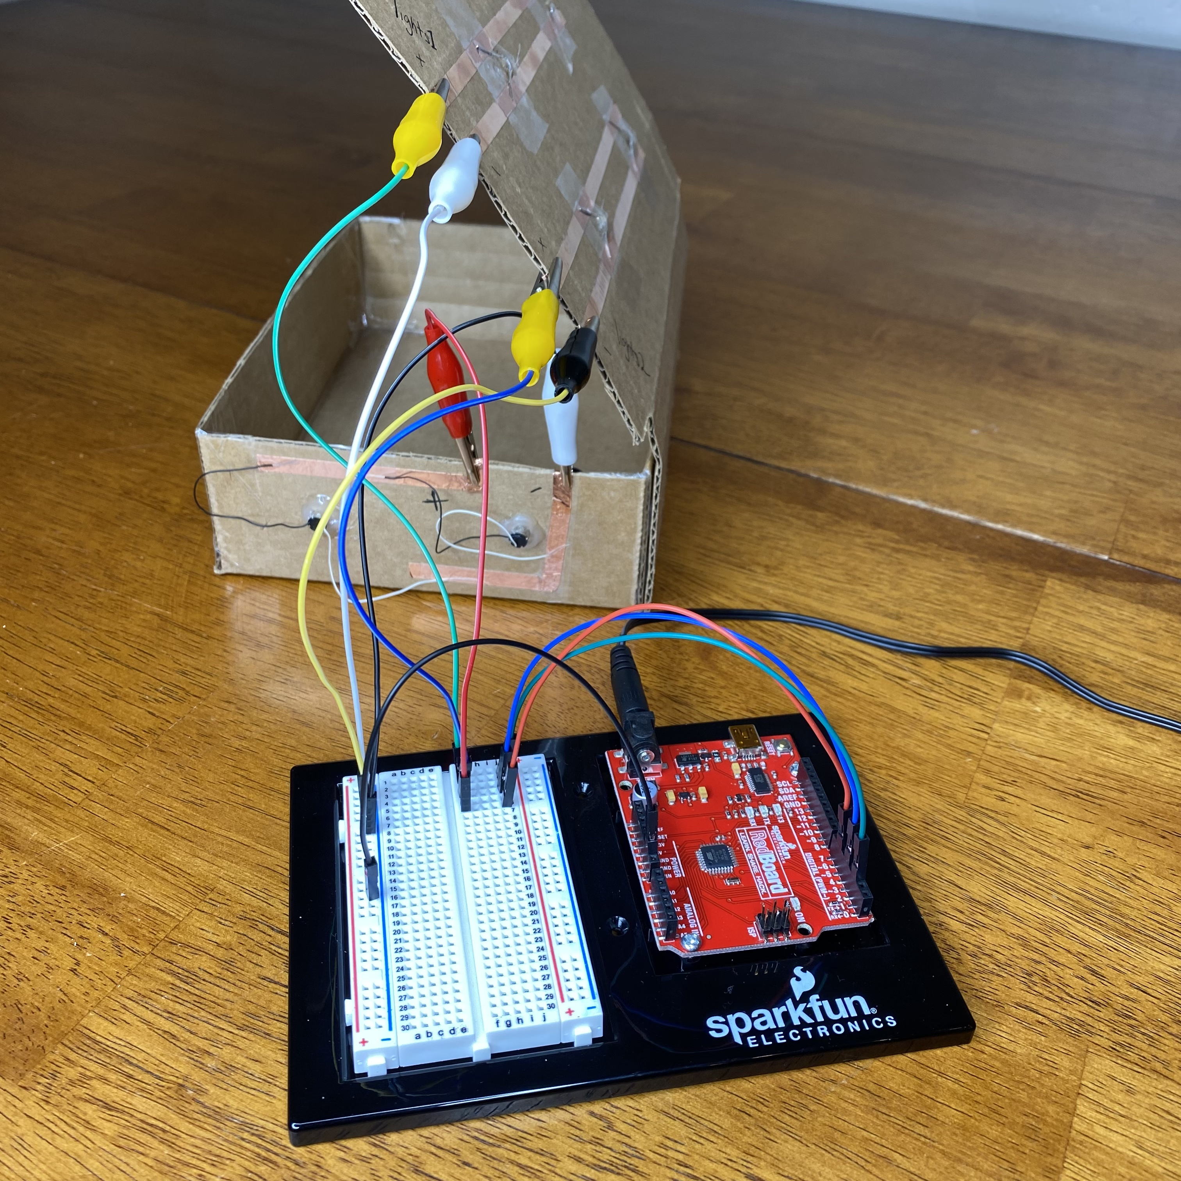
CONNECT THE TEST LEADS TO THE HEN HOUSE. POSITIVE TO POSITIVE. NEGATIVE TO NEGATIVE. PIN 2 AND PIN 4 WILL CONTROL LIGHTS AND PIN 6 WILL CONTROL THE FAN.
Positive
Negative

Slide 17
ADD POWER TO THE ARDUINO.
ONCE THE ARDUINO HAS POWER THE HEN HOUSE LIGHTS AND FANS WILL TURN ON AND OFF.

